Slide 1

Basic Details of the Team and Problem Statement
Ministry/Organization Name/Student Innovation:
Ministry of Commerce and Industries
PS Code: SIH1385
Problem Statement Title: Developing a software that can translate resource material and other texts from English to other Indian regional languages
Team Name: Team 404
Team Leader Name: Mustafa Masuldar
Institute Code (AISHE): C-15716
Institute Name: N B Navale Sinhgad College of Engineering , Solapur.
Theme Name: Smart Education

Slide 2
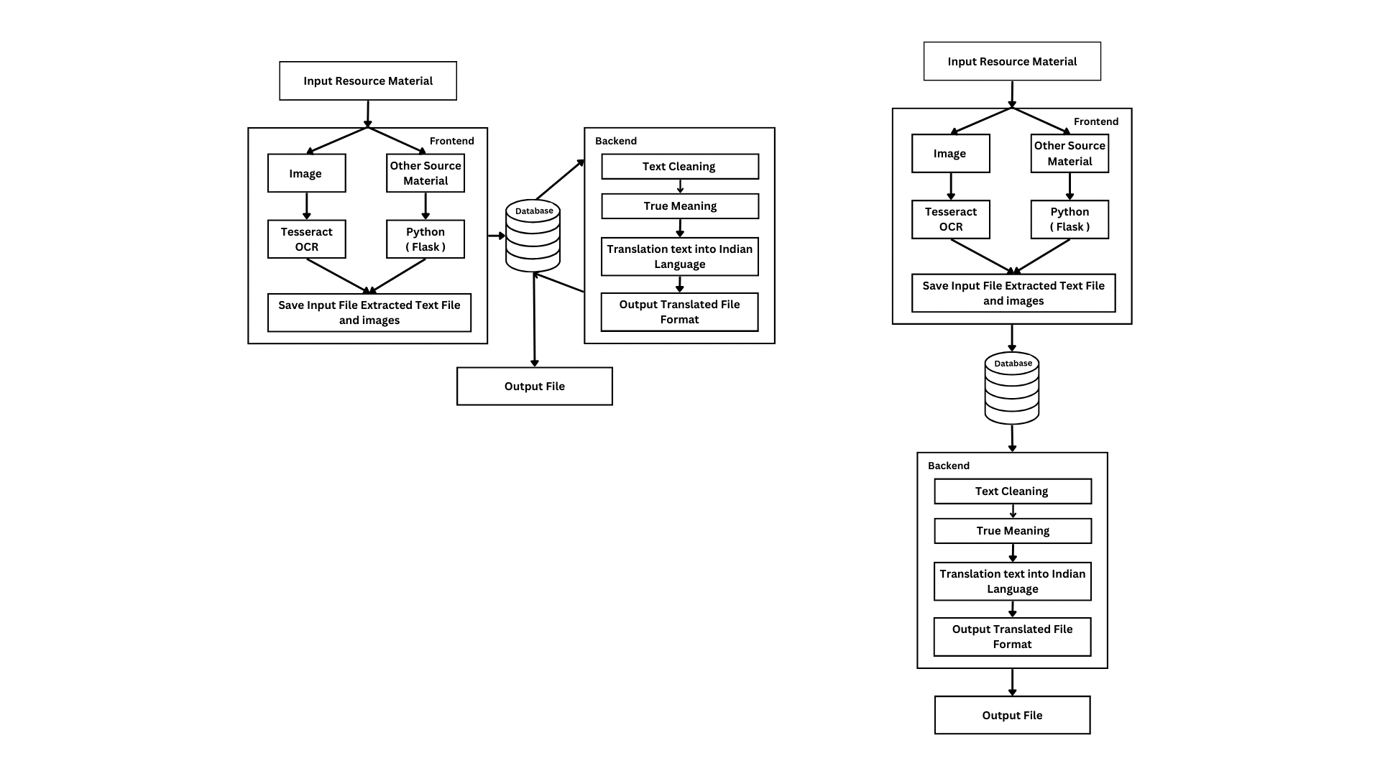
Idea/Approach Details
Vision:
Our vision is to create a unified platform where language is no longer a barrier to understanding Intellectual Property Rights. We aim to empower people across India by providing seamless translation of IPR resources. Through our solution, we envision a society where knowledge flows freely, fostering innovation and collaboration, irrespective of linguistic differences
User Input:
Users can type in English or upload documents directly on our website. This provides flexibility for users to input their content in a way that's convenient for them.
Clear Images (OpenCV):
We use OpenCV, a computer vision library, to enhance image clarity. OpenCV sharpens images, making the text within them clearer and improving the accuracy of text extraction.
Text Extraction (Tesseract OCR):
For scanned images or documents, we employ Tesseract OCR (Optical Character Recognition) technology. Tesseract converts images into editable text, enabling seamless processing of scanned content.
Save Your Work (Database Integration):
Our system integrates with a secure database where users can store both their original inputs and translated outputs. This feature allows users to retrieve their work later for reference.
Correct Spelling:
We implement spelling correction algorithms that automatically identify and rectify spelling errors in the extracted text. These algorithms ensure the accuracy of the content being translated.
Technology stack:
Translation API+Flask(Framework)
Tesseract OCR
NLP + Python libraries (PyPDF2,
Gramformer, Translator ,cv2)
HTML, CSS, JS (Frontend) , PHP

Slide 3
Idea/Approach Details
6. Fix Grammer (Gramformer Library):
Gramformer a powerful library, is used to check and correct grammar errors in the text .This step ensures that the translated content is not only grammatically correct but also reads naturally and fluently
7. Translate Correctly:
We employ specialized translation algorithms that take the corrected text and translate it into the user's preferred language. These algorithms consider context, idiomatic expressions, and cultural nuances, delivering accurate and meaningful translations.
8. Quality Check:
A combination of automated checks and human review ensures the translation's quality. Algorithms verify linguistic accuracy, ensuring that the translated content is faithful to the original meaning and Intent.
9. Choose Your Format:
Users have the flexibility to receive the translated text in various formats such as Word or PDF. This choice accommodates different user preferences and requirements.
Use Cases:
Students' Education: Enable translation of educational materials from English to Indian languages, enhancing accessibility for students.
Government Services: Translate official announcements and documents into regional languages, ensuring vital information for citizens.
CIPAM's Resources: Translate educational tools, including images and PDFs, into Indian regional languages for broader reach.
Business Communication: Provide real-time translation for effective communication between individuals and businesses speaking different languages.
Dependencies:
Source Material
Development of a machine translation library
Access to a diverse and large dataset for training the translation models
Development of an intuitive and user-friendly interface for users to input text and receive translations .
Features:
Multi-Modal Input:
Supports text, document uploads, and speech recognition for diverse user inputs..
Custom Terminology Support:
Allows users to add domain-specific terms for accurate translations in specialized fields.

Slide 4
Team Member Details
Team Leader Name : Mustafa Masuldar
Branch : Btech Stream : CSE Year : IV
Team Member 1 Name : Sakshi Deshmukh
Branch : Btech Stream : CSE Year : IV
Team Member 2 Name : Pooja Pawar
Branch : Btech Stream : CSE Year : IV
Team Member 3 Name : Nandini Madre
Branch : Btech Stream : CSE Year : IV
Team Member 4 Name : Iram Muchale
Branch : Btech Stream : CSE Year : IV
Team Member 5 Name: Nikita Jagdale
Branch : Btech Stream : CSE Year : III

